Slide 1
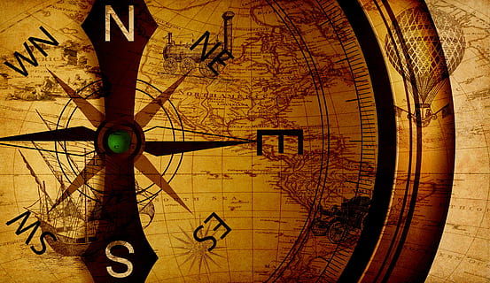
DIRECTION SENSE
LOGICAL REASONING

Slide 2
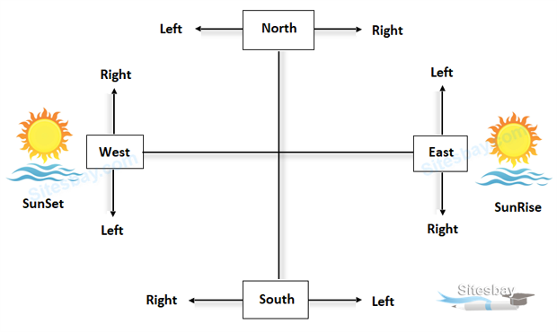

Slide 3
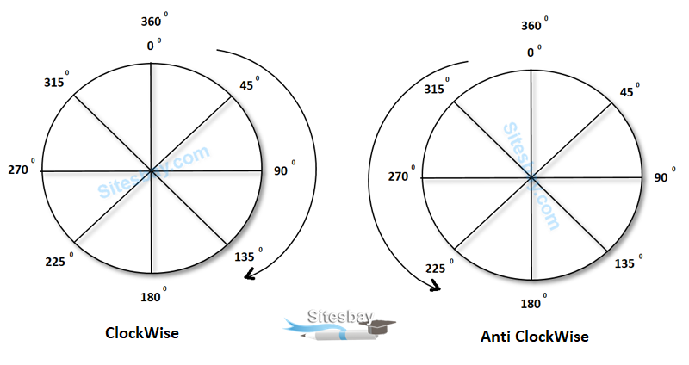

Slide 4
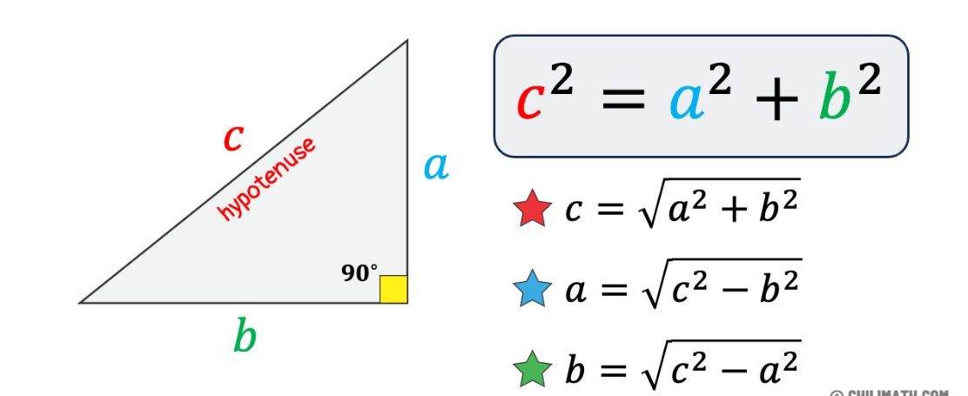
PYTHAGORAS THEORAM

Slide 5
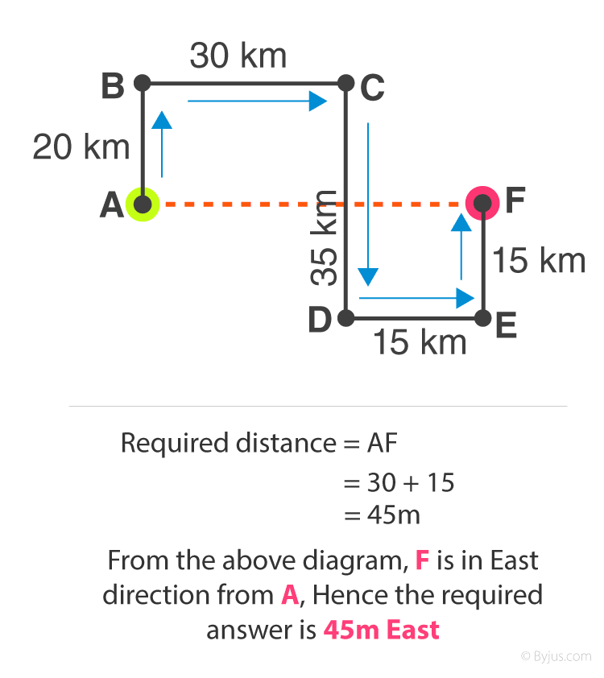
Example: Sowmya walked 20 m towards the north. Then she turned right and walks 30 m. Then she turns right and walks 35 m. Then she turns left and walks 15 m. Finally she turns left and walks 15 m. In which direction and how many meters is she from the starting position?

Slide 6
1) Y is in the East of X which is in the North of Z. If P is in the South of Z, then in which direction of Y, is P?
A. North
B. South
C. South-East
D. None of these

Slide 7
2)Rasik walked 20 m towards north. Then he turned right and walks 30 m. Then he turns right and walks 35 m. Then he turns left and walks 15 m. Finally he turns left and walks 15 m. In which direction and how many meters is he from the starting position?
A. 15 m West
B. 30 m East
C. 30 m West
D. 45 m East

Slide 8
A is 10 m to the west of N. N is 15m to the east of K. K is exactly at middle between H and B such that HKB form a vertical straight line of 40 m. B is to the south of K. 3)K is at what distance and in which direction with respect to A?
(1)5 m, South
(2)10 m, North
(3)5 m, West
(4)15 m, East

Slide 9
A is 10 m to the west of N. N is 15m to the east of K. K is exactly at middle between H and B such that HKB form a vertical straight line of 40 m. B is to the south of K. 4)H is at what distance and in which direction with respect to N?
(1)25 m, South-east
(2)25 m, North-west
(3)25 m, North-east
(4)24 m, North-east

Slide 10
A is 10 m to the west of N. N is 15m to the east of K. K is exactly at middle between H and B such that HKB form a vertical straight line of 40 m. B is to the south of K. 5)A is approximately at what distance and in which direction with respect to B?
(1)21 m, South-east
(2)22 m, North-west
(3)21 m, North-east
(4)21 m, North-east

Slide 11
6) One morning Udai and Vishal were talking to each other face to face at a crossing. If Vishal's shadow was exactly to the left of Udai, which direction was Udai facing?
A. North
B. South
C. East
D. South

Slide 12
7)Rahul put his timepiece on the table in such a way that at 6 P.M. hour hand points to North. In which direction the minute hand will point at 9.15 P.M. ?
A. North
B. South
C. East
D. West

Slide 13
8)Sristi started walking towards north to reach his school. After reaching the school she turned 180° in clockwise direction and 45° in anticlockwise direction. Which direction is she facing now?
A. North - West
B. North - East
C. South – West
D. South – East

Slide 14
9)There are 7 family members P, Q, R, S, T, U and V standing in ground in which there are 2 married couples. P is sister of Q who is maternal grandson of T. Maternal grandfather of Q is standing 3m to the right of Q who is facing north. The father of S has 2 maternal grandchildren. V is facing north. V is standing 4m to the south of maternal grandson of U. S is 2m to the right of V. P is 1m south of S and 1m west of U. R is sister-in-law of V and standing 9m to the north of her mother. V is father of P. U is a Female. Maternal Granddaughter of U is standing in which direction with respect to her husband?
A. South - East
B. South
C. North
D. South - West

